Slide 1
Investigating Robustness of VLMs using LLMs
2024-04-22
Kanishk Jain, Nathan Cormerais, Youry Macius

Slide 2
Plan
Introduction
Motivation
Related Work
Contributions
Our Approach
Experiments
Results
Conclusion & Future Work
Notes:
Introduction (Youry)
VLMs & LLMs (Youry)
Robustness in VLMs (Youry)
Aims of this work (Kanishk)
Methods (Kanishk)
Experiments (Nathan)
Results (Nathan)
Conclusion & Future Direction (Nathan)

Slide 3
Introduction
1.0
VLMs have gained popularity for tasks such as question answering
Investigating Robustness of VLMs using LLMs
22-04-2024

Slide 4
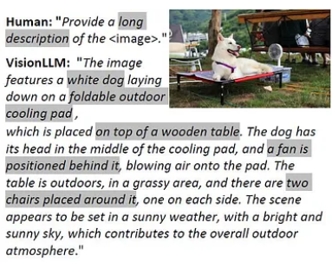
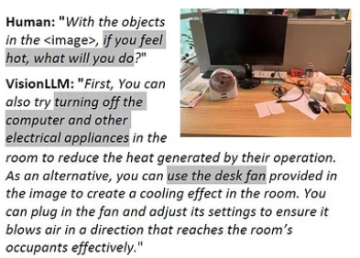
Introduction
Wenhai Wang and al., May 2023, https://arxiv.org/abs/2305.11175

Slide 5
Vision Language Models (VLMs)
“Vision language models are broadly defined as multimodal models that can learn from images and text. They are a type of generative models that take image and text inputs, and generate text outputs.”
https://huggingface.co/blog/vlms#:~:text=Vision%20language%20models%20are%20broadly,inputs%2C%20and%20generate%20text%20outputs.
Titre de la présentation
JJ-MM-AAAA

Slide 6
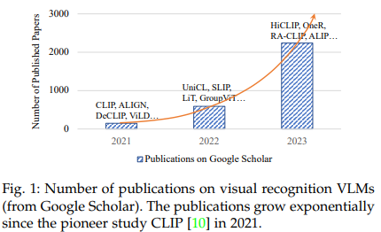
History of VLMs
“Image Captioning with Neural Networks” by Oriol Vinyals and al., 2015
“Vision-Language Models for Vision Tasks: A Survey”, by Jingyi Zhang, Feb 2024 :
Notes:
First known paper, published in 2015: “Image Captioning with Neural Networks” by Oriol Vinyals and al.
This paper delves into using deep learning techniques to automatically generate captions for images
Emergence of OpenAI’s CLIP and Google’s ALIGN

Slide 7
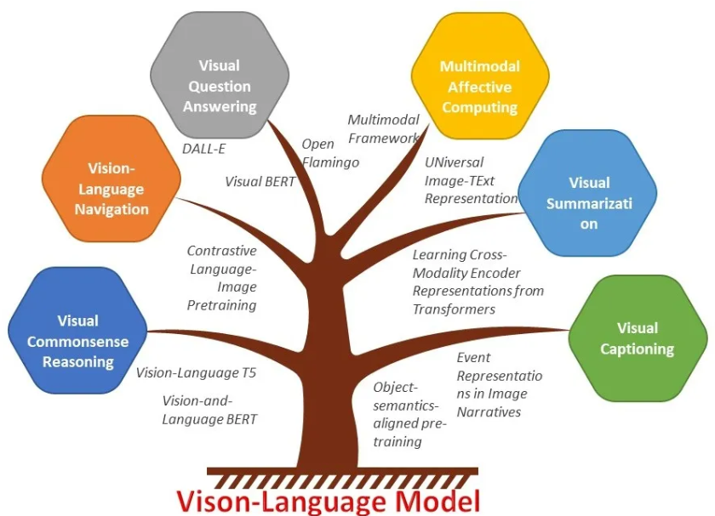
Main tasks performed by VLMs

Slide 8
Related work
3.0
VLMs Robustness, ViLT model and OOD Question Generation
Investigating Robustness of VLMs using LLMs
22-04-2024

Slide 9
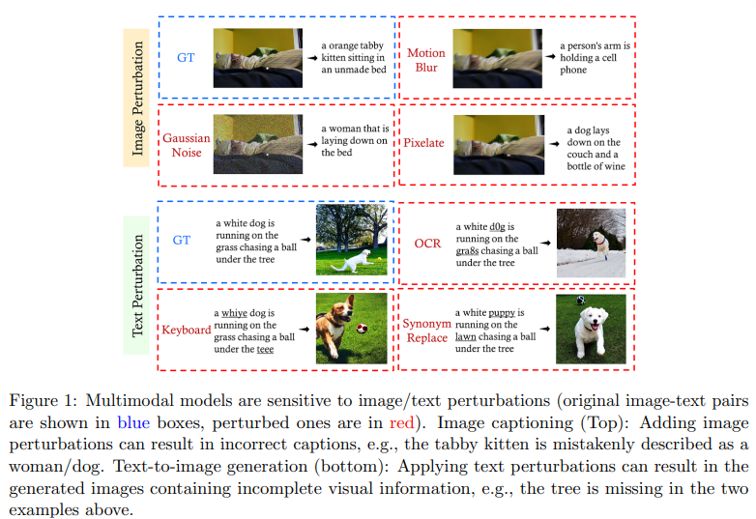
VLMs Robustness
“Benchmarking Robustness of Multimodal Image-Text Models under Distribution Shift”, Jan 2024
https://arxiv.org/pdf/2212.08044.pdf

Slide 10
OOD (Out-Of-Distribution) question generation
OOD (Out-of-Distribution) question generation refers to the task of generating questions that are outside the distribution of the training data, but still relevant and meaningful. It can help improve the robustness and generalization of language models and question answering systems.
There are several approaches to OOD question generation, including:
Paraphrasing: generating paraphrased versions of existing questions
Template-based generation: using templates to generate new questions
Language model-based generation: using language models to generate new questions
Hybrid approaches: combining multiple methods above
Notes:
OOD (Out-of-Distribution) question generation refers to the task of generating questions that are outside the distribution of the training data, but still relevant and meaningful. This is an important area of research in natural language processing (NLP) and artificial intelligence (AI), as it can help improve the robustness and generalization of language models and question answering systems.
There are several approaches to OOD question generation, including:
Paraphrasing: generating paraphrased versions of existing questions
Template-based generation: using templates to generate new questions
Language model-based generation: using language models to generate new questions
Hybrid approaches: combining multiple methods above

Slide 11
Motivation
2.0
Investigating Robustness of VLMs using LLMs
22-04-2024

Slide 12
Motivation
Challenges faced by VLMs for VQA tasks
Struggle significantly when faced with questions that fall outside their training distribution
Answer question without utilizing the visual context in the image
Leverage shortcuts in the dataset in the form of biases

Slide 13
Contributions
4.0
Investigating Robustness of VLMs using LLMs
22-04-2024

Slide 14
What kind of Questions fool VLMs?
Currently we rely on humans for coming up with questions
Can we do better than this?
Replace humans with LLMs with visual context

Slide 15
Contributions
Setup a two agent chat framework b/w VLM and LLM for OOD question generation based on two approaches
Few-Shot Prompting
Proximal Policy Optimization
Qualitative comparison between Few-Shot and PPO based approaches
Understanding the failure cases of different generations of VLMs with Quantitative comparisons

Slide 16
Our Approach
5.0
Investigating Robustness of VLMs using LLMs
22-04-2024

Slide 17
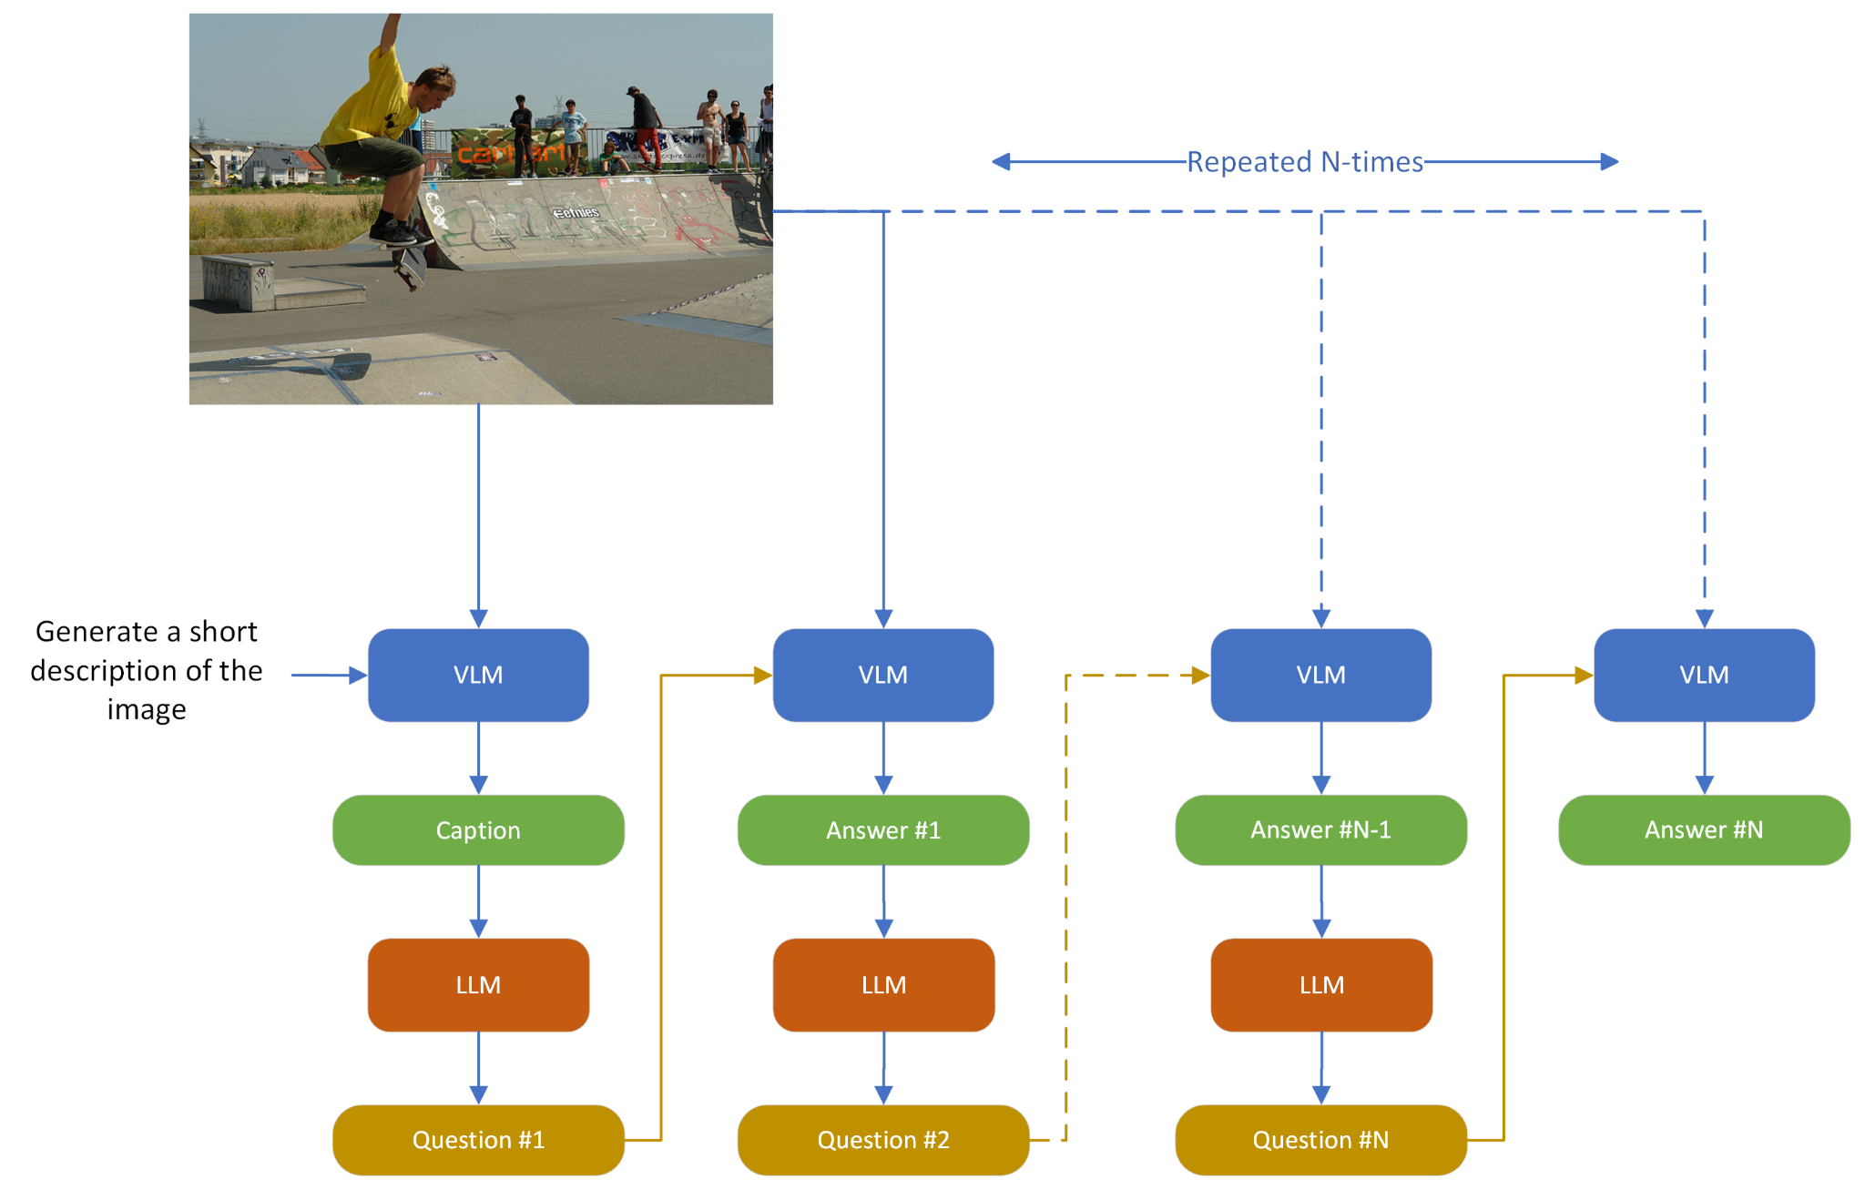
Two Agent Chat Framework
Goal: Leverage LLM to generate questions about image that VLM is not able to answer correctly
However LLM only takes text as input
Leverage Image Captions to bridge this gap

Slide 18
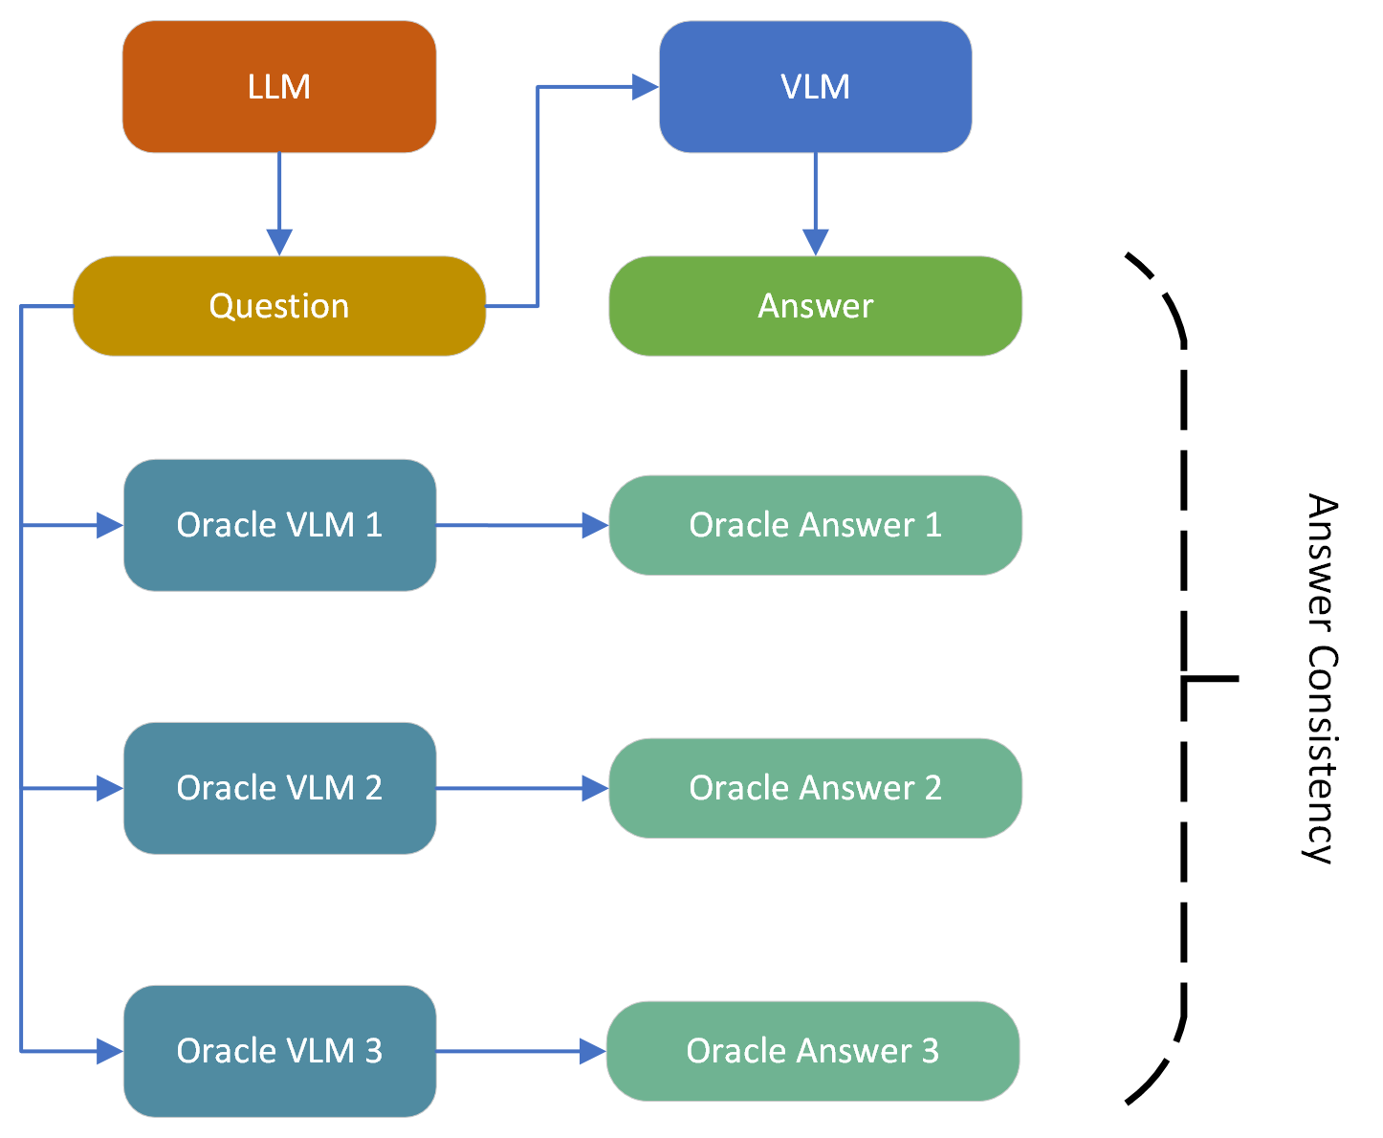
How to verify VLM answer?
Use a heuristic based verification criteria
Probe multiple VLMs
Use Semantic similarity b/w oracle answers and VLM answer as measure of correctness

Slide 19
Approaches for LLM Question Generation
Few-Shot Prompting
Provide in-context examples of the task
No explicit feedback during question generation
Proximal Policy Optimization
Use VLM Answer correctness as reward signal
Use reward as feedback to optimize LLM to generate questions that VLM fails to answer correctly

Slide 20
Experiments
6.0
Investigating Robustness of VLMs using LLMs
22-04-2024

Slide 21
Dataset
Visual Question Answering
Task is to provide an accurate natural language answer
Both questions and answers are open-ended
https://arxiv.org/pdf/1505.00468.pdf
VQA v2.0
443,757 training and 214,354 validation samples
multiple questions per image
At least 3 questions (5.4 questions on average) per image
10 ground truth answers per question
3 plausible (but likely incorrect) answers per question
https://arxiv.org/pdf/1612.00837v3.pdf

Slide 22
Evaluation
Robustness of different types of VLMs to Question Paraphrasing
Qualitative Comparison b/w Few-shot and PPO based Question Generation
Metrics for Measuring Robustness
String Matching
Strict and requires exact match
Heuristic Matching
Considers partial match but ignores semantics
LAVE
LLM-based and takes semantics into account

Slide 23
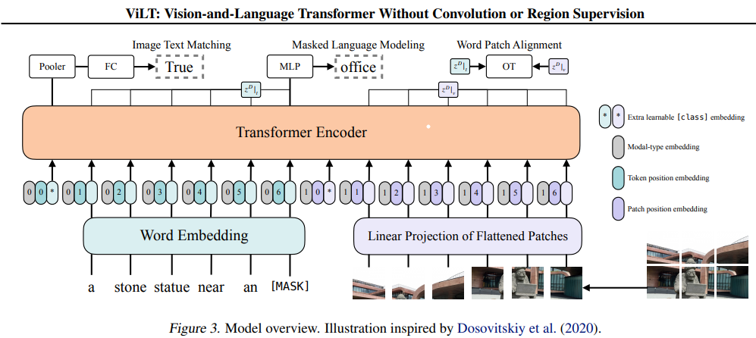
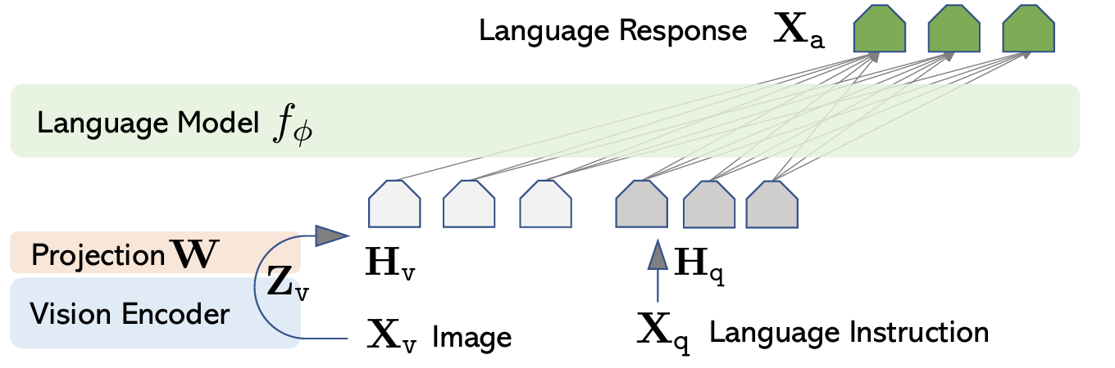
Baseline Models
ViLT model
Fine-Tuned on VQA
Tackles VQA as a Classification Task
e.g Yes/No, colors, numbers
Large Language and Vision Assistant (LLaVA 1.5)
Pre-trained on Large Scale data
Generates free-form text as answer
Capable of multiple tasks such as image captioning, VQA etc.

Slide 24
Models Used for Question Generation
LLM
OpenHermes-2.5-Mistral-7B
Probing VLMs
Internlm-xcomposer2-vl-7b
Deepseek-vl-7b-chat
Llava-v1.6-mistral-7b-hf
All models are open-source and downloaded from huggingface

Slide 25
Results
7.0
Quantitative and qualitative results from our experiments
Investigating Robustness of VLMs using LLMs
22-04-2024

Slide 26
Quantitative results (1)
Results using a subset of VQA v.2.0 (1 question/image)
200 total questions
Model | String matching accuracy | Heuristic accuracy | LAVE score
ViLT (Fine-tuned) | 70.0% | 72.0% | 83.25%
LLaVA (Zero-Shot) | 61.0% | 64.0% | 74.50%

Slide 27
Quantitative results (2)
Results using paraphrasing (≃ 10 questions/image)
2132 total questions
Model | String matching accuracy | Heuristic accuracy | LAVE score
ViLT (Fine-tuned) | 54.69% | 56.28% | 72.65%
LLaVA (Zero-Shot) | 54.36% | 58.72% | 74.06%
Notes:
New generation of VLM are more robust to paraphrasing than older generation of models, as the drop in VilT performance is huge (~10 %) on paraphrased questions, while LLava retains its performance and outperforms the fine-tune VilT on VQA-V2 dataset

Slide 28
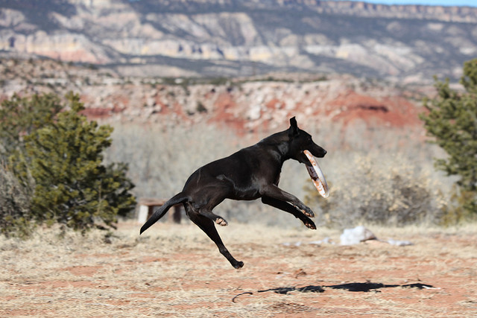
Qualitative results
Using a subset of the VQA v.2.0 dataset on ViLT
Using initial question
Q: Is the dog jumping?
T: Yes
A: Yes
Using paraphrased questions (word synonym)
Q: Is the dog hopping?
T: Yes
A: No
Q: Is the dog bounding?
T: Yes
A: Yes
*Q: question
*T: ground truth
*A: predicted answer

Slide 29
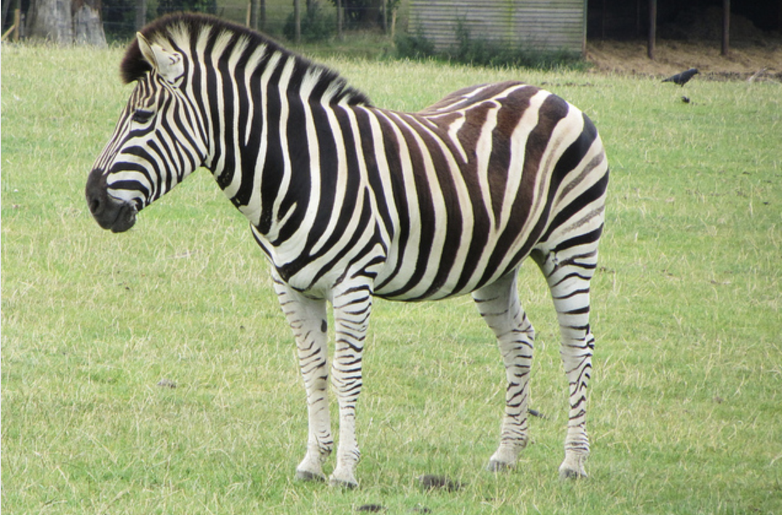
Qualitative results For Few-Shot Prompting
LLM: Are there any other animals visible in the field? Llava 1.5: No, there are no other animals visible in the field. Internlm-xcomposer2: No, there are no other animals visible in the field besides the zebra. DeepSeek Answer: Yes, there is a bird visible in the field near the zebra. Llava 1.6: Yes, there is a bird visible in the field behind the zebra.
LLM: What is the color of the zebra's stripes? Llava 1.5: The zebra's stripes are black and white. Internlm-xcomposer2: The zebra has black and white stripes DeepSeek Answer: The zebra's stripes are brown and white. Llava 1.6: The zebra's stripes are black and white.
A zebra standing in a grassy field.

Slide 30
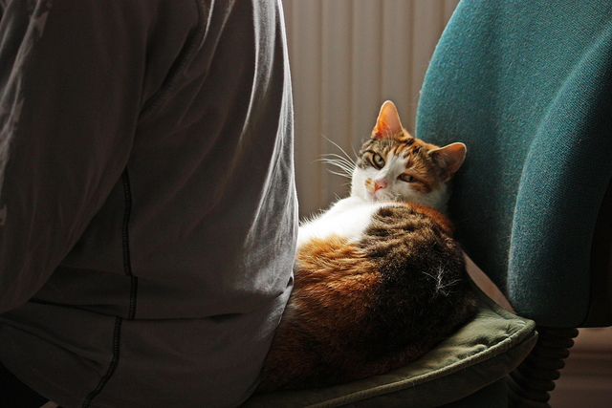
Qualitative results For PPO
LLM: Is the cat wearing any accessories or collars on its neck? Llava 1.5: The cat is wearing a collar on its neck Internlm-xcomposer2: No, the cat is not wearing any collars on its neck. DeepSeek Answer: The cat is wearing a collar in the image Llava 1.6: The cat in the image does not appear to wear any collar on its neck
LLM: What is the color of the cat's collar? Llava 1.5: The cat's collar is white. Internlm-xcomposer2: I cannot see the cat's collar in the image. DeepSeek Answer: The cat is not wearing a collar. Llava 1.6: The cat in the image is not wearing a collar.
A cat is sitting on a chair next to a person.

Slide 31
Conclusion
8.0
Investigating Robustness of VLMs using LLMs
22-04-2024

Slide 32
Conclusion
Older VLMs like ViLT are vulnerable to paraphrasing of question and result in significant performance drop
Newer VLMs like Llava are more robust to question paraphrasing and retain the performance
LLMs show promise in enabling automatic discovery of failure modes of current SOTA VLMs like Llava
Compared to few-shot learning, PPO provides direct feedback to LLM to optimize question generation for fooling VLMs

Slide 33
Future work
9.0
Investigating Robustness of VLMs using LLMs
22-04-2024

Slide 34
On-going work
Experimenting with PPO for large number of steps
Automatic Clustering of questions to discover failure modes of VLMs
Use LLM for computing the answer consistency with oracle VLMs
Leverage Regularization Technique such as CutMix in visual and linguistic modalities to enable VLM to focus on visual context

Slide 35
Thank you !

